Slide 1
Detecting Freezing of Gait Episodes in Parkinson's Disease Patients using Deep Learning
Prepared By
Rahul Stanly Keecheril
DATA AND PARTICIPANT CATEGORIES: D0
“I confirm that I have followed the ethical guidance provided by the university for this project. Any changes to the data or participant categories, or any new evaluation activities, have been updated in this statement and approved by my supervisor before implementation

Slide 2
Understanding Freezing of Gait (FOG) in Parkinson's Disease
Definition: A common motor symptom in Parkinson’s where patients temporarily feel "stuck," unable to initiate or continue walking.
Why FOG Matters:
Leads to increased fall risk, injuries, and loss of independence.
Affects mobility and quality of life, often causing anxiety about movement.
Triggers: Narrow spaces, turns, and high-stress situations.
Importance of Detection:
Early detection is critical for targeted therapies and personalized interventions.
Monitoring FOG helps researchers and clinicians better understand Parkinson's progression.

Slide 3

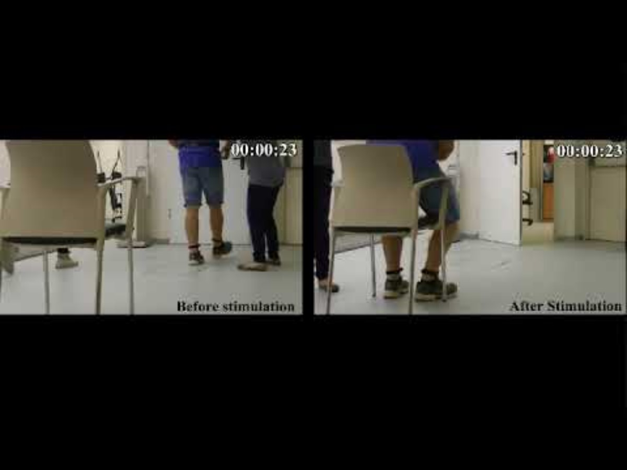
Video: comparison before and after tdcs

Slide 4
THE DATASET
2 Datasets: One before TDCS and one after TDCS (defog)
TDCS: Transcranial direct current stimulation is a non-invasive brain stimulation technique that uses a weak electrical current to stimulate the brain
Both contained acceleration data along time and what caused FoG in the patient

Slide 5
Dataset contd..
Attributes
AccV (Vertical): Measures vertical movement.
AccML (Medial-Lateral): Measures side-to-side movement.
AccAP (Anterior-Posterior): Measures forward and backward movement.
Target Variables:
Start Hesitation: Indicates if the patient hesitated while starting to walk.
Turn: Captures if the patient underwent a FOG episode while making a turn.
Walking: Whether a FOG episode occurred while walking.

Slide 6

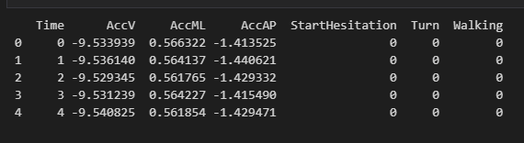
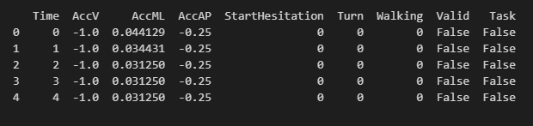
Dataset contd..
Furthermore, the defog dataset had 2 other attributes called VALID and TASK to indicate whether the event occurred under observation or not.
The TDCS dataset was created when the patient was under 24/7 observation
Time: An integer timestep. Series from the tdcsfog dataset are recorded at 128Hz (128 timesteps per second), while series from the defog and daily series are recorded at 100Hz (100 timesteps per second).
TDCS DATASET
DEFOG DATASET

Slide 7
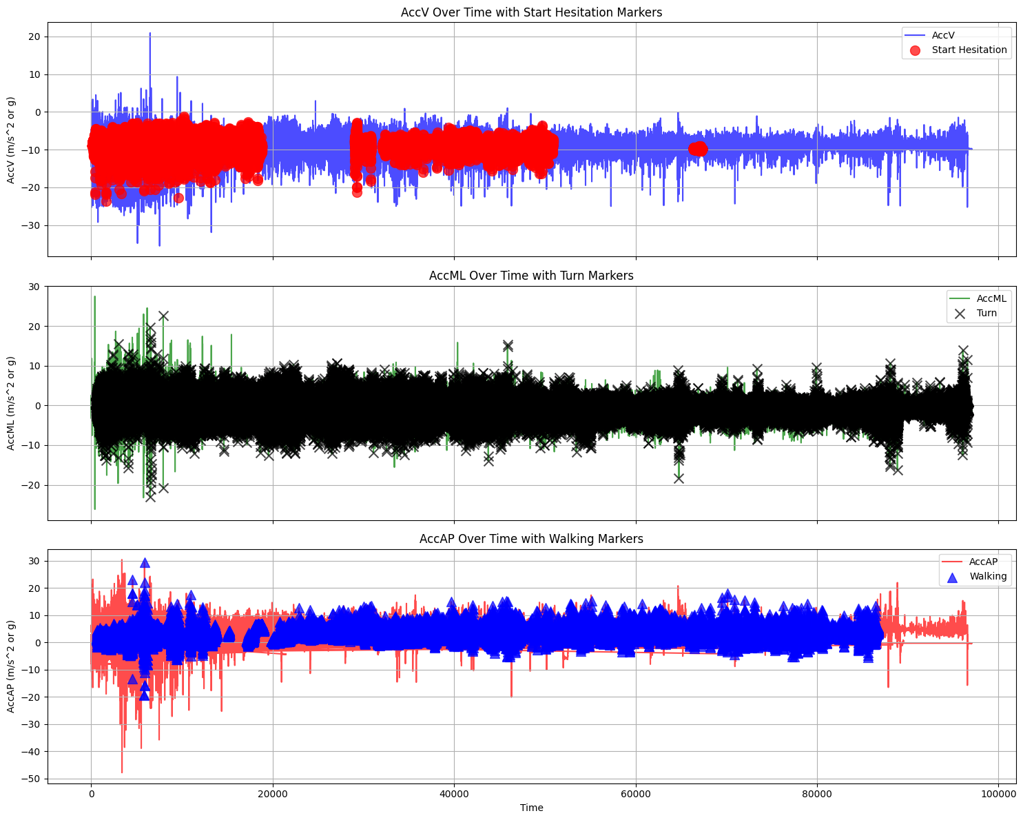
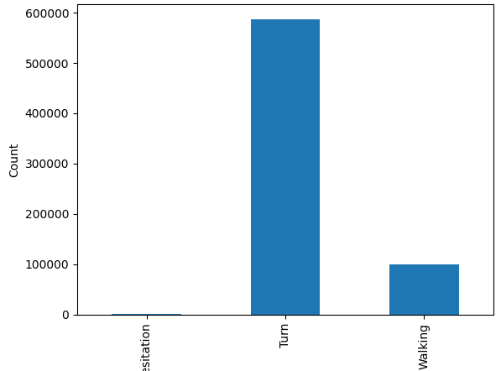
Data cleaning and exploration(Defog dataset)
Filtered the defog dataset to only have rows where valid and task were labelled as 1.
Events where start hesitation was 1 were very less compared to turn or walking.
We had a highly unbalanced dataset.

Slide 8
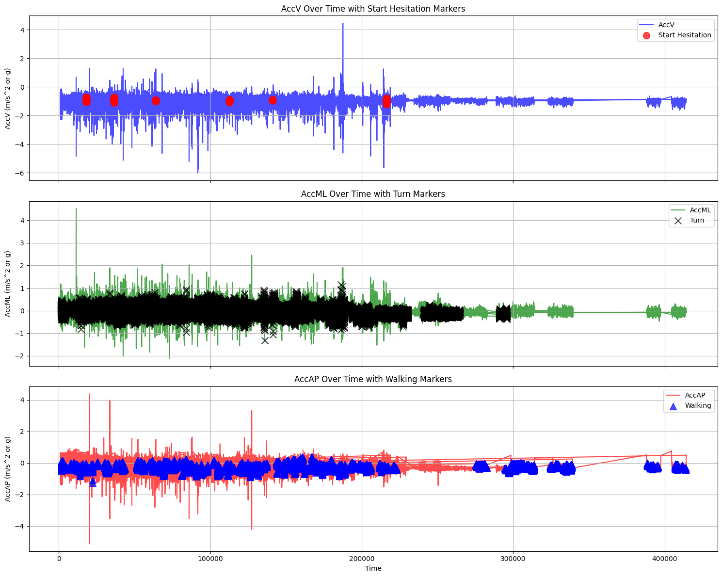
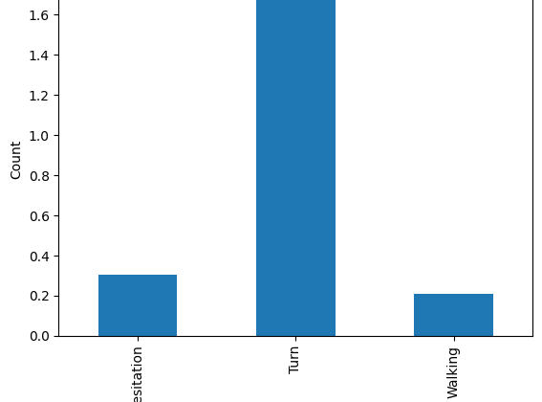
Data cleaning and exploration(TDCS dataset)
Events where start hesitation was 1 were very less compared to turn or walking.
We had a highly unbalanced dataset similar to the defog dataset.

Slide 9
Initial Objective
First Objective: Develop an LSTM Model
Approach:
LSTM was chosen for handling time-series sensor data.
Expected to capture temporal patterns in movement data.
Outcome:
Low accuracy in detecting FOG episodes.
LSTM struggled to effectively learn from the dataset.

Slide 10
Shift in Approach
After LSTM’s Low Performance:
Decided to explore MLP (Multi-Layer Perceptron) as an alternative.
MLP performed better, despite lacking time-series capabilities.
Leveraged feature engineering for better model input.

Slide 11
Feature engineering
Temporal Features:
Sine/Cosine Transformations: Capture periodic patterns.
Rolling Statistics:
Mean & Std: Smooth data and measure movement variability.
Feature Interactions: Combine accelerometer axes for new insights.
Normalization: Scale features for better model training.

Slide 12
Challenges Faced
Large data volumes and handling missing values.
Low Performance of LSTM: Expected high performance from LSTM but needed to change approach.
Class Imbalance: Some movement classes were underrepresented, impacting model accuracy

Slide 13
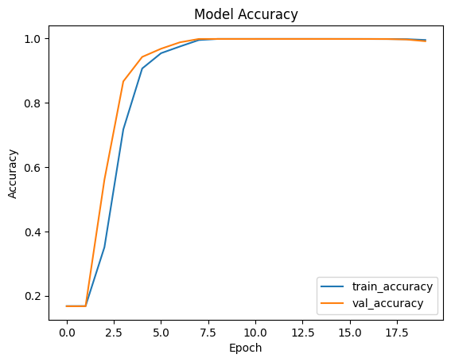
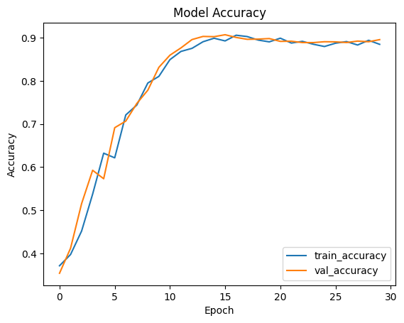
RESULTS
Developed FOG Detection Models
Created machine learning models tailored for detecting FOG events in Parkinson's patients.
Processed two datasets: Baseline and Post-tDCS (Transcranial Direct Current Stimulation) to predict FOG on both datasets
Model Accuracy & Adjustments
Initial LSTM model achieved low accuracy; changed to Multi-Layer Perceptron (MLP) for improved results.
Performed extensive tuning and feature engineering to optimize model performance.

Slide 14
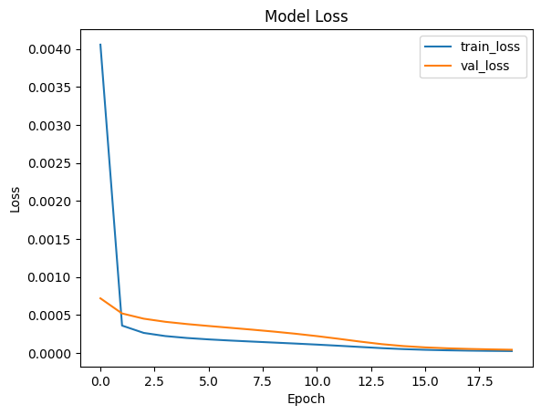
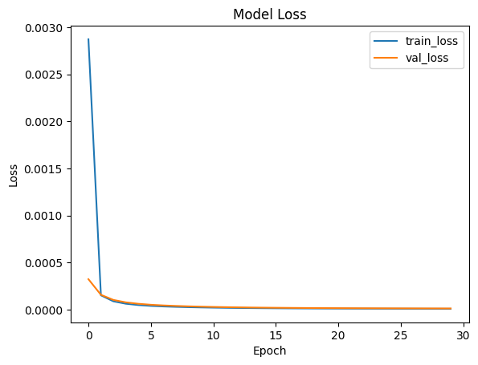
RESults contd..
The loss graphs

Slide 15
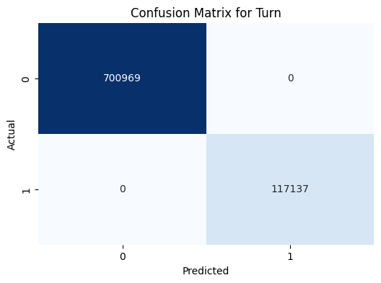
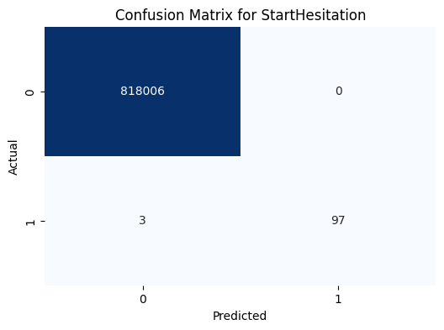
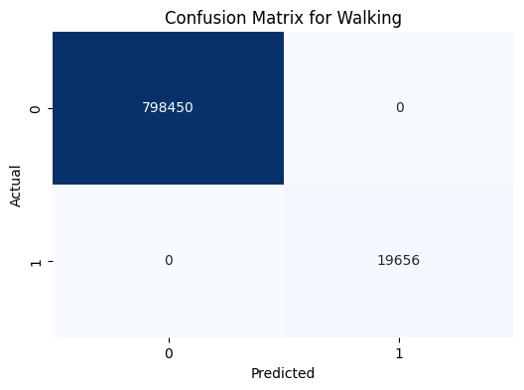
Confusion matrices: Base dataset

Slide 16
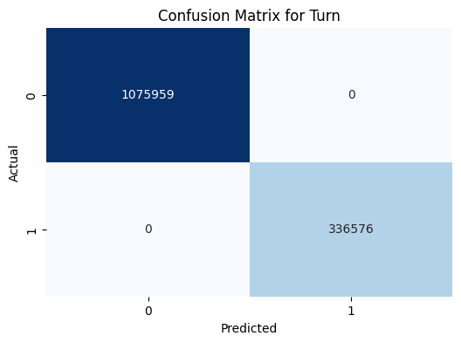


Confusion matrices: tDcs dataset

Slide 17
Future Directions
Future iterations could integrate additional brain signal data (e.g., EEG) to enhance FOG prediction accuracy and real-time monitoring potential.

Slide 18

THANK YOU

